Slide 1

🌾 Agricultural Micro-Loan Predictor
Empowering Kenyan Farmers and SACCOs with AI-Driven Credit Decisions
NGAO LABS CAPSTONE PROJECT

Slide 2
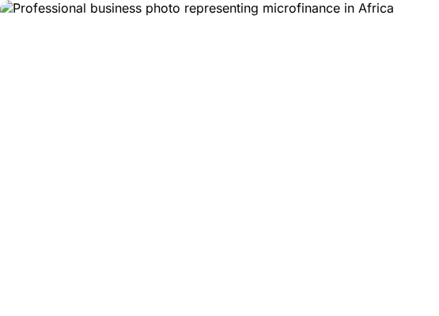
The Challenge: Default Risks
Kenyan microfinance institutions and SACCOs face significant financial risk from loan defaults in the agricultural sector.
Manual credit assessments are often:
Slow and resource-intensive
Inconsistent across branches
Prone to human bias
Our Goal: Automate default risk prediction using machine learning for faster, fairer, and safer lending.

Slide 3






Solution Architecture
Data Engineering
AI Modeling
Web Dashboard
Processed over 26,000 historical loan and demographic records to extract behavioral features like repayment delays and loan intensity.
Trained multiple architectures, deploying a tuned XGBoost Ensemble optimized for catching high-risk defaults via threshold tuning.
Built an interactive Streamlit application offering real-time risk scoring alongside transparent SHAP explanations for every prediction.

Slide 4


Data & Class Imbalance
The dataset exhibits a significant class imbalance, which is typical in credit scoring scenarios:
~78% Good Loans (Successfully Repaid)
~22% Bad Loans (Defaulted)
This imbalance requires advanced mitigation techniques like SMOTE (Synthetic Minority Over-sampling) and cost-sensitive model weighting to prevent the AI from defaulting to "always approve".

Slide 5


Feature Engineering Strategy
Behavioral Metrics
Applicant Demographics
Derived features capturing historical interaction proved to be the strongest risk drivers:
Processed demographic variables to understand the applicant's background context and stability:
Key Variables:
Key Variables:
Average repayment delay
Age at loan application
Late payment indicators & ratios
Employment status (e.g., Self-Employed)
Total previous loans & loan intensity
Bank account types & education level

Slide 6

Model Convergence & ROC Analysis
We benchmarked deep learning models against gradient-boosted trees:
PyTorch ShallowMLP: Baseline neural network.
PyTorch DeepTabNet: Deeper architecture for tabular data.
XGBoost Tuned Ensemble: Primary production model.
The Tuned XGBoost model consistently outperformed the neural networks on this tabular dataset, achieving a Validation AUC-ROC of ~0.72+.

Slide 7

Baseline Confusion Matrices
Initial models were trained using SMOTE at the default classification threshold of 0.5.
While accuracy was high, analyzing the confusion matrices revealed a critical flaw:
Too many actual defaults were being classified as safe (false negatives).
In agricultural micro-finance, the cost of a missed default is much higher than declining a safe loan.

Slide 8

Optimizing for Default Recall
To address the false negative issue, we performed Classification Threshold Tuning.
By lowering the decision threshold from 0.50 to ~0.10 - 0.25 on the XGBoost model, we heavily prioritized Default Recall.
Dramatically increased detection of bad loans.
Proved more effective than SMOTE alone in catching defaults.

Slide 9

Final Model Comparison
After applying both synthetic over-sampling (SMOTE) and our recall-optimized threshold logic, the final metrics clearly identify the winner.
XGBoost Tuned Ensemble delivers superior separation capability, balancing the need to approve good farmers while protecting SACCOs from high-risk defaults.

Slide 10


Interactive Web App
We developed an end-to-end Streamlit dashboard for loan officers.
Key Capabilities:
•
Real-time scoring based on demographics and loan terms.
•
Dynamic calculation of behavioral insights.
•
Clear High-Risk / Low-Risk indicators.
•
Built-in dark/light mode functionality.

Slide 11
Responsible AI & Key Findings
Transparent SHAP Explanations We eliminated the "Black Box." Every web app prediction includes a feature impact analysis, showing loan officers exactly *why* an applicant was flagged (e.g., specific repayment delay impacts).
Algorithmic Fairness Audits Disaggregated AUC-ROC analysis across employment sub-groups (Self-Employed, Permanent, etc.) ensured consistent model performance, mitigating systemic bias against vulnerable demographics.
Human-in-the-Loop Design Prominent transparency disclaimers reinforce that the AI is a decision-support tool, designed to assist—not replace—institutional policy, human judgment, and regulatory compliance.

Slide 12
Questions?
Thank you for exploring our Capstone Project.
Ngao Labs Capstone Team | Agricultural Micro-Loan Predictor

Slide 13

Image Sources
https://lookaside.fbsbx.com/lookaside/crawler/media/?media_id=1311576620998004
Source: www.facebook.com

